Slide 1
Optimization Algorithm for Ray Tracing:
Computer Graphics
Nguyen Quang Trung
Le Duc Tuyen
Nguyen Viet Anh Tuan
Phung Minh Quang
Group 6:

Slide 2
01
Introduction
02
Ray Tracing – Technique Overview
03
Optimization Algorithm
04
Further constraints & Conclusion
Overall look and real life examples
Simple, high-level explanation of the technique
How we can use algorithm to increase performance
Program’s constraints and possible improvement

Slide 3
01
Introduction
x
y
Ray Tracing is one of the most popular graphics techniques in recent years, both in offline and real-time graphics renderers.

Slide 4
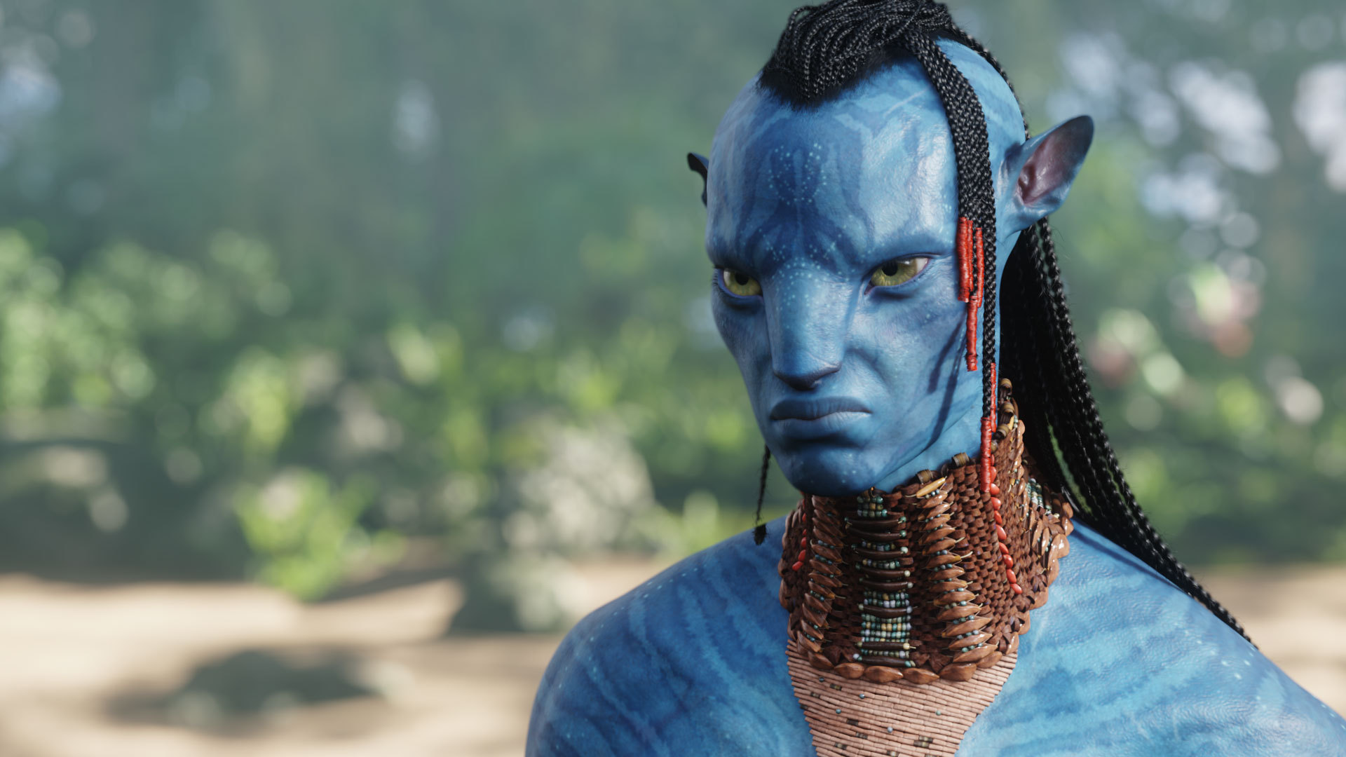
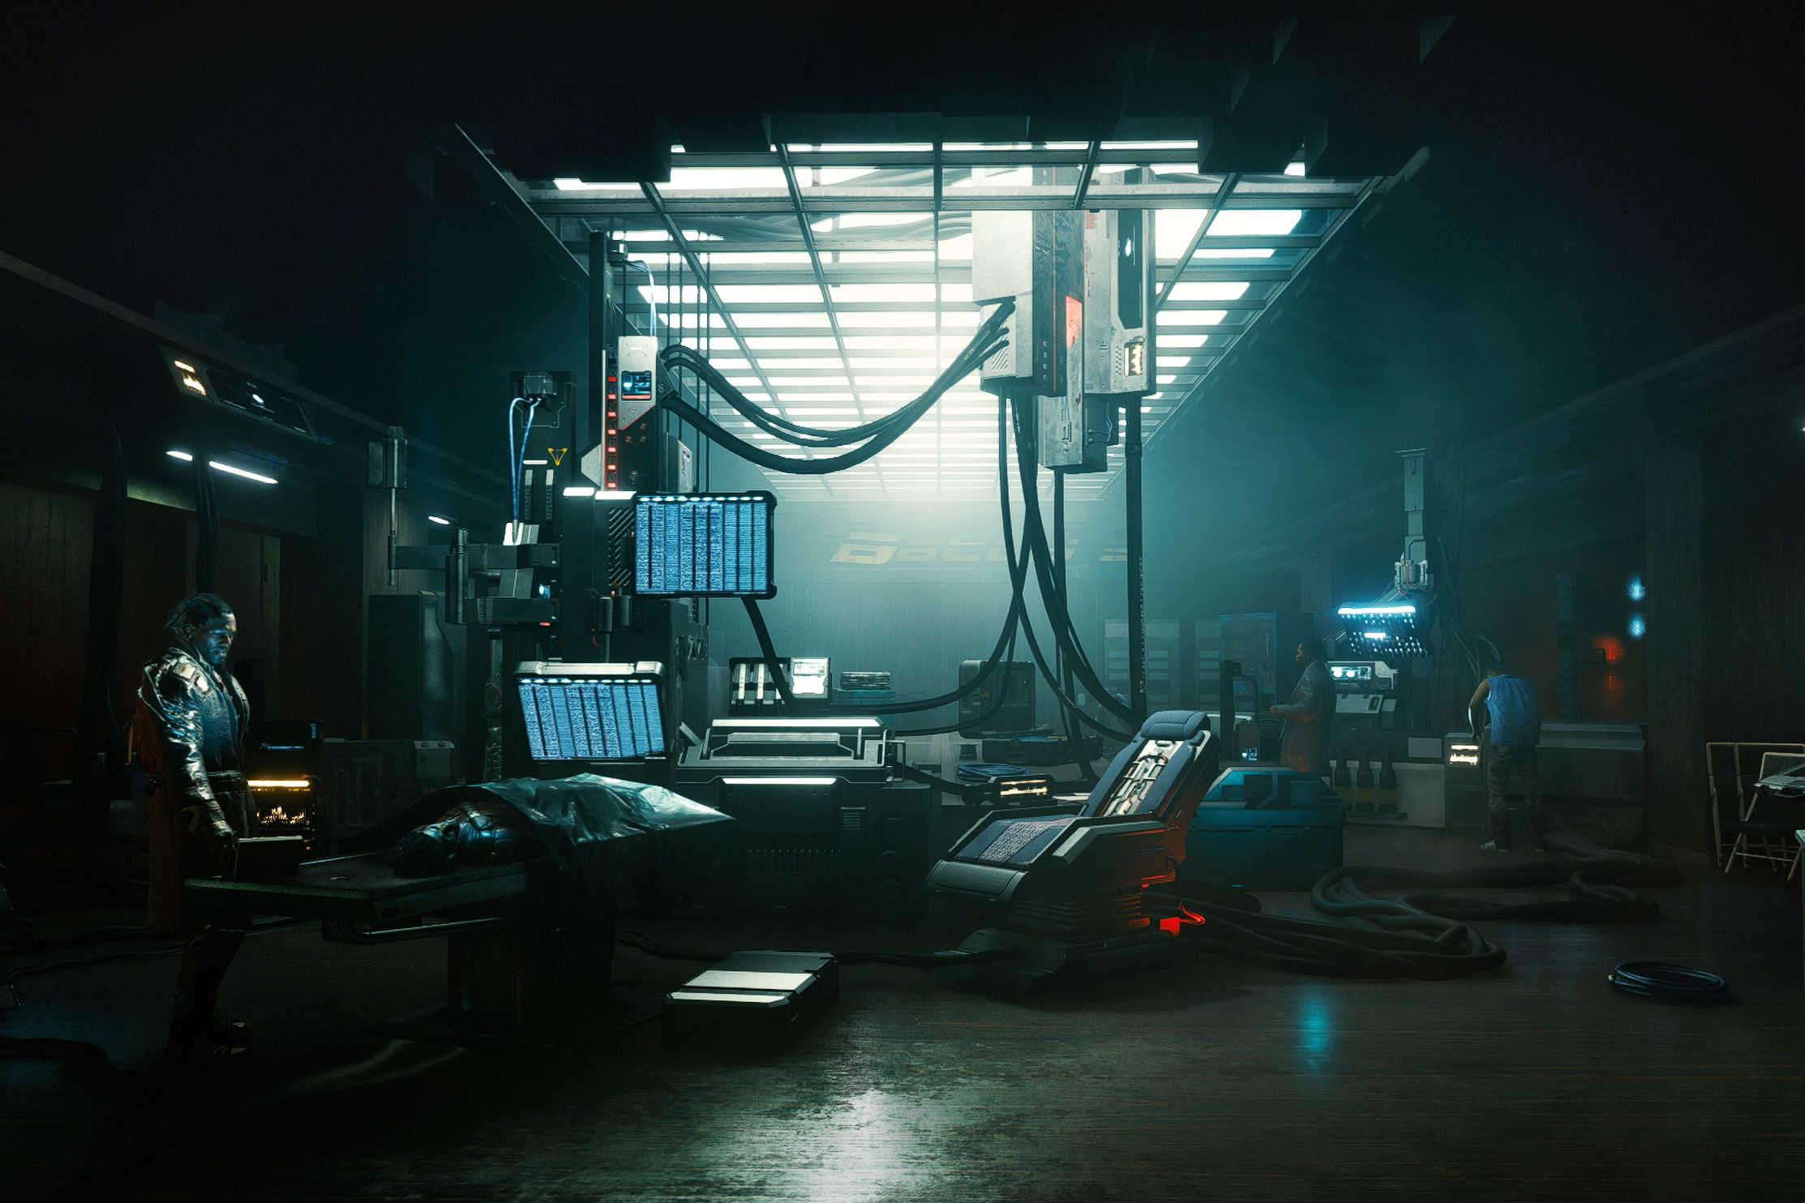
1.1 What is Ray Tracing?
In Computer Graphics, engineers are pushing for more realism
→ Ray Tracing is crucial in helping achieving that.

Slide 5
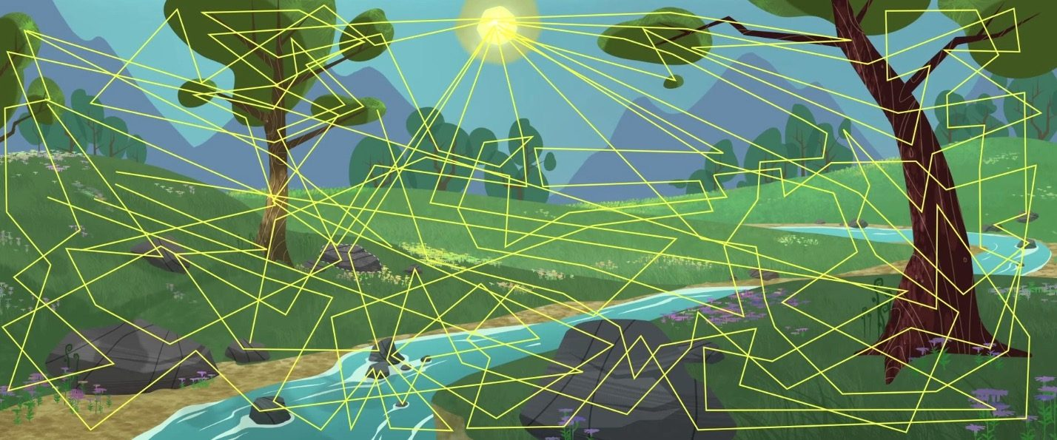

1.1 What is Ray Tracing?
In real life, light sources emit trillions of light rays that travel and interact in space.
Ray Tracing is used widely to mimic real life
Areas that are directly hit by these rays appear brighter, while areas that are blocked retain shadows.

Slide 6
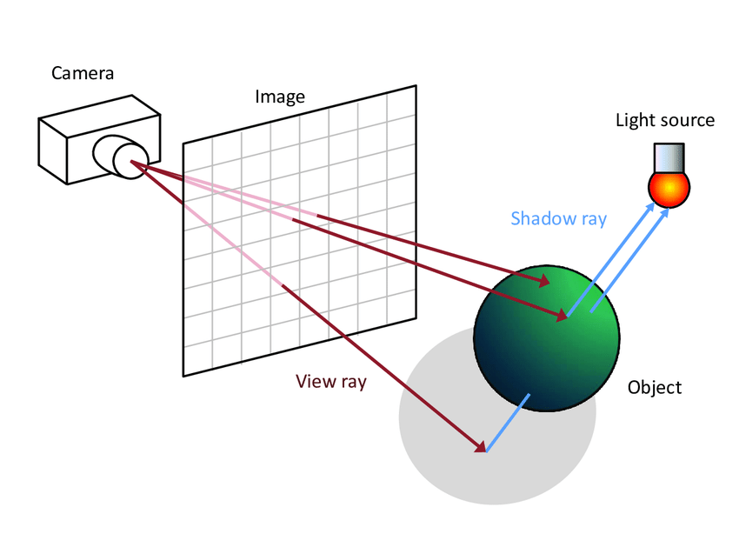
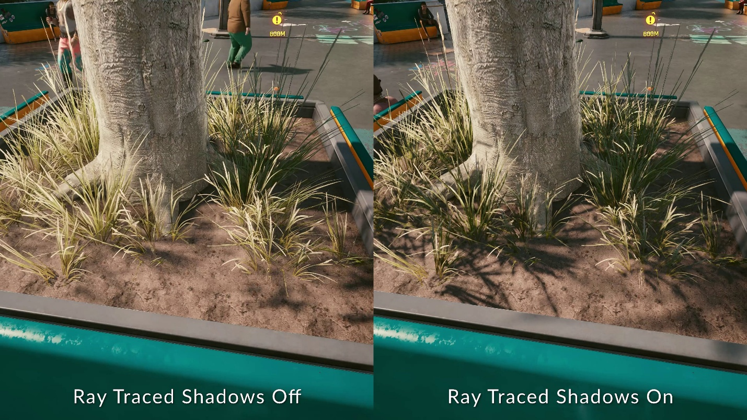
1.1 What is Ray Tracing?
In Ray Tracing, instead of light rays coming from the light sources, we have a virtual camera shooting the rays into the scene that collect data, finally define which color to display on every pixel.
The described technique is called Ray Traced Shadows, which helps generate physically-accurate shadows
Example Image

Slide 7

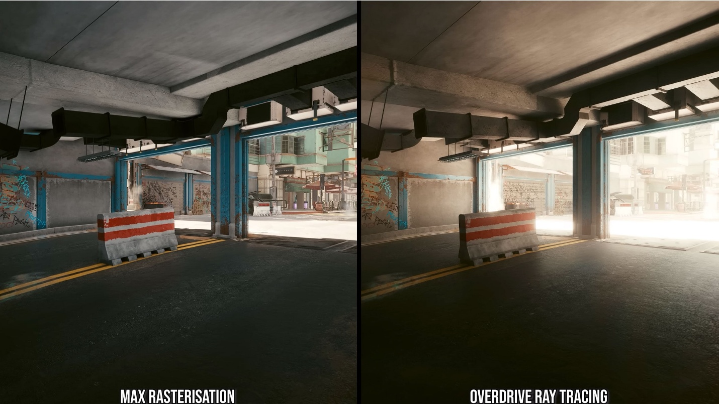
1.2 Why Ray Tracing?
Movies
Video games
Ray Tracing is popularly used because it simulates physically accurate light interactions, making the visual output realistic.

Slide 8
02
Overview
x
y
Ray Tracing Technique Overview

Slide 9
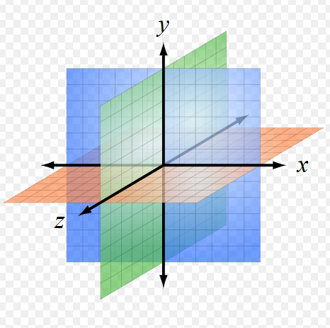
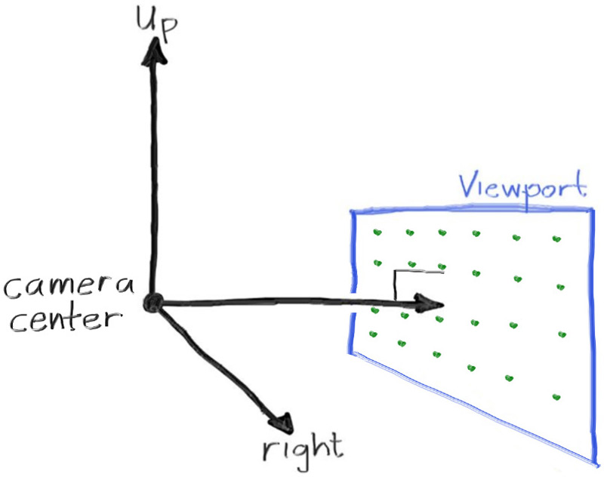
2.1 How to trace rays into the scene
A 3D coordinate space system
A Virtual Camera at position (0, 0, 0)

Slide 10
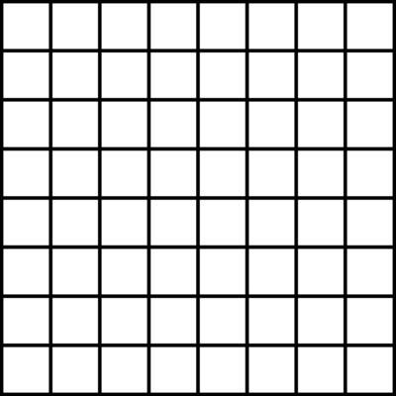
2.1 How to trace rays into the scene
A viewport to represent the locations of the screen pixels
We calculate the directions of the rays and positions of the objects
An 8x8 viewport

Slide 11
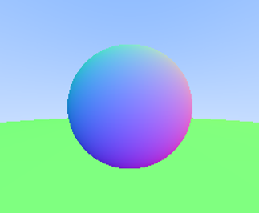
2.1 How to trace rays into the scene
With the defined mathematical positions and radiuses, we can visualize 2 simple spheres
For pixels that the rays don’t hit anything, we assign color blue to represent the sky
A simple ray-traced scene

Slide 12
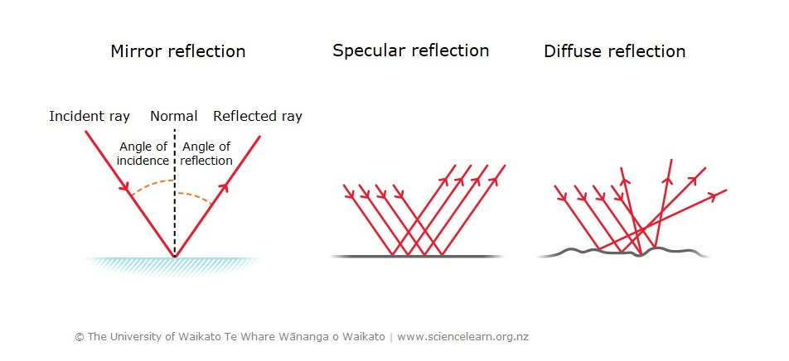
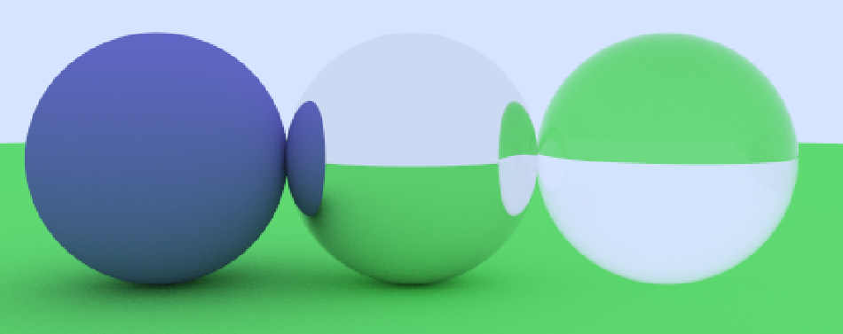
2.2 How to add complexity
To add complexity, different material types are assigned to objects, which react differently to rays
Diffuse
Metallic
Dielectric

Slide 13
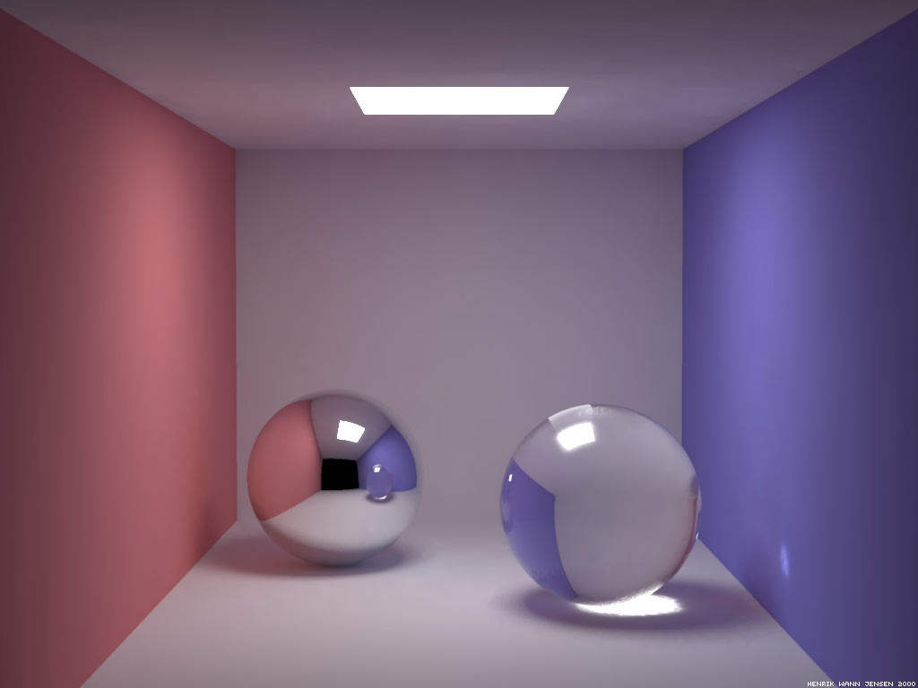
2.2 How to add complexity
Those are ray-object intersection, which adds different effects to the scene:
Lighting
Reflection
Shadows

Slide 14
03
Optimization Algorithm
x
y
How using algorithm can improve performance and efficiency

Slide 15
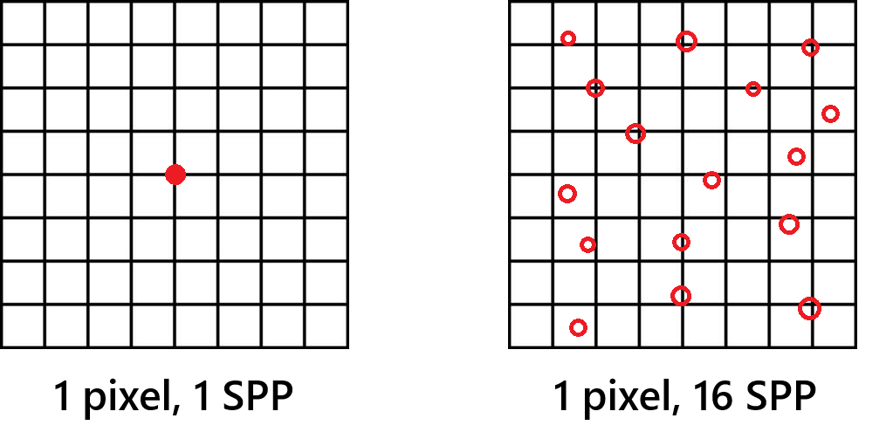
3. Optimization Algorithm
Actually, Ray Tracing requires more than just 1 ray per pixel to achieve good quality.
A Monte Carlo Multisampling method

Slide 16
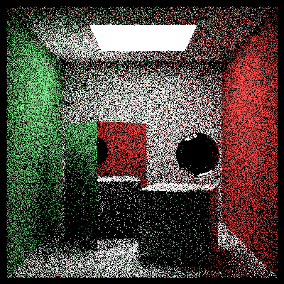
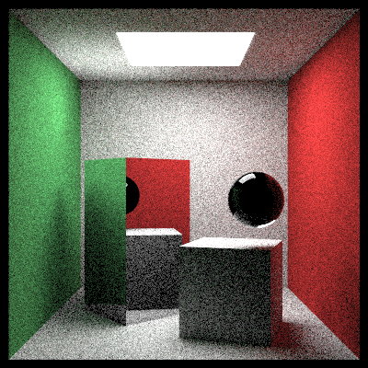
3. Optimization Algorithm
A Monte Carlo Multisampling method
16 samples
256 samples

Slide 17
3. Optimization Algorithm
The problem of Ray Tracing:
Increasing Samples Per Pixel slows down rendering
Suppose we have:
Image resolution: 1920 x 1080 = 2073600 pixels
Samples Per Pixel: 200
Ray bounce limit: 10
That means more than 4 billion rays have to be calculated.
In large-scale production, that means trillions of many times more complex ray traversals than this presentation’s program.
→ Proposed Optimization Algorithm: Bounding Volume Hierarchy

Slide 18
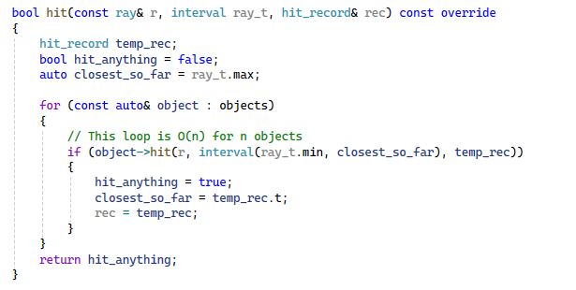
3. Optimization Algorithm
We need to loop through every n objects → O(n) complexity

Slide 19
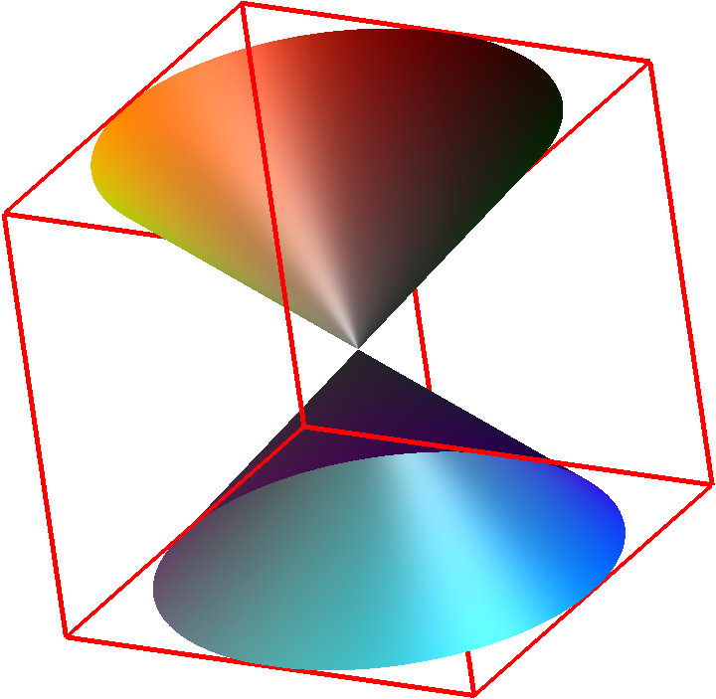
3. Optimization Algorithm
We can wrap objects in virtual boxes. If a ray miss a box, we don’t have to consider the objects inside it.
Parent node
Left node
Right node

Slide 20
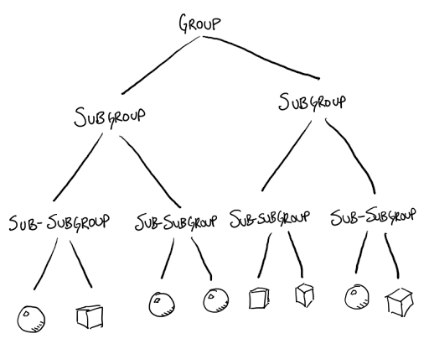
3. Optimization Algorithm
By dividing objects into a hierarchy tree like this, we can achieve O(log n) complexity

Slide 21
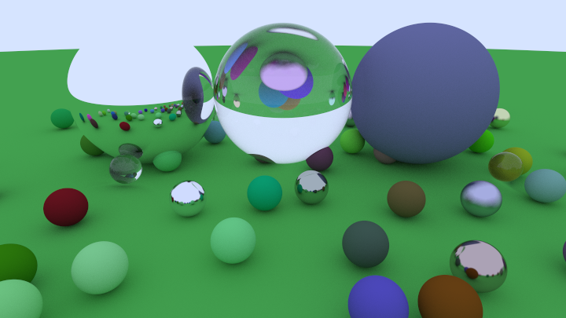
3. Optimization Algorithm
Program demo:

Slide 22
04
Constraints & Conclusion
x
y

Slide 23
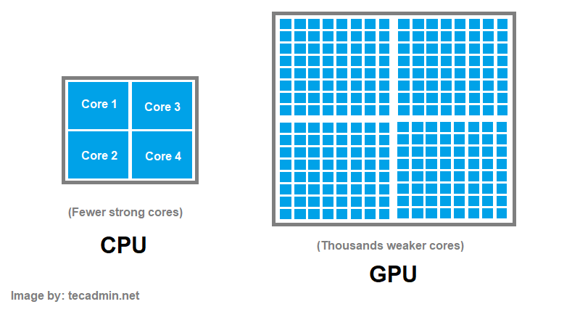
4. Constraints & Conclusion
Ray Tracing technique is extremely computationally expensive.
Ray Tracing can be implemented on CPU or GPU, which both has their own advantages and disadvantages.
To make the algorithm easier to understand and experiment with, our program in this presentation runs entirely on the CPU, where operations are performed mostly sequentially.

Slide 24
4. Constraints & Conclusion
When rendered on CPU, this comes with several downsides:
Much slower execution time, as CPUs generally have far fewer cores than GPUs.
Limited ability to support high resolutions, high sample counts, or deep ray recursion, which directly affect image quality.
Computational complexity becomes a bottleneck — without optimization structures (like BVH), ray tracing on the CPU quickly becomes impractically slow even for relatively simple scenes.
However, in film and VFX Production, CPUs are still heavily used because ray traversal can get too complex for the GPUs.

Slide 25
4. Constraints & Conclusion
To take advantages of the GPU power, we need to use modern graphics APIs that support the features of Ray Tracing.
GPUs can trace many rays at the same time, but there are still some limitations:
Memory limits: Very large or complex scenes might not fit into GPU memory.
Different ray paths: Some rays bounce or reflect differently, which can slow down the GPU.
Limited recursion: Rays bounce many times → too much GPU resources.
Data transfer: Extra time when moving scene data between CPU and GPU.
Even with these constraints, GPUs are very good at handling large numbers of rays in parallel, which is why modern games and graphics applications often use them.

Slide 26
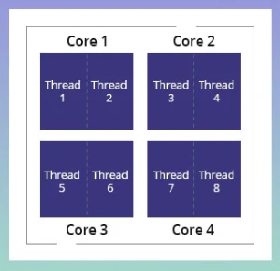
4. Constraints & Conclusion
In our implementation, despite running on the CPU, we were still able to achieve a form of parallel computing using a CPU feature called multithreading.
Our program runs on Visual Studio, which runs with single-core by default.
→ Enabling multithreading allows our ray tracer to use all available CPU threads, significantly speeding up the rendering process.

Slide 27
Thank you for listening!!
If you have any questions, feel free to ask us right away!!

